Slide 1
breakout
Atari, 1976
Nolan Bushnell
Steve Wozniak
Steve Bristow
42 TTL
Deepmind, 2013
Playing Atari with Deep Reinforcement Learning
CNN + FC
publication

Slide 2
Abraham Alcaina
Omar Brid
Bernat Martinez
Atari Breakout
repository
https://github.com/DaniFojo/aidl-2020-spring-team-dani
Team 2

Slide 3
Motivation of the project

Slide 4
What is Reinforcement Learning?
Motivation of the Project

Slide 5

In Reinforcement Learning we have an agent in an unknown environment that can obtain some rewards by interacting with it. The agent ought to take actions so as to maximize cumulative rewards.
Motivation of the Project

Slide 6
Why Reinforcement Learning?
Motivation of the Project

Slide 7
Increasingly used in the industry
Rapidly growing learning resources
We believe it has a bright future
Motivation of the Project

Slide 8
What did we achieve?
Motivation of the Project

Slide 9
Vanilla Policy Gradient
Advantage Actor Critic
Policy Proximal Optimization
The Atari Challenge
Motivation of the Project

Slide 10
Why Atari and Breakout?
Motivation of the Project

Slide 11
It’s complexity was a reasonable challenge
Was part of Deepmind breakthrough with RL
Sparked Wozniak and Jobs onto grander things
Motivation of the Project
Playing Atari with Deep Reinforcement Learning, Deepmind, 2013

Slide 12
Milestones

Slide 13


Goals presented in the Critical Review
RL algorithms
Implement PPO
Solve environments
Vanilla Policy Gradients
Advantage Actor Critic (A2C)
Comparably to state-of-the-art approaches in Reinforcement Learning
Use PPO to solve some of the following environments:
OpenAI gym
Some Atari game
CARLA*
Milestones
Notes:
Simple RL algorithms:
Vanilla Policy Gradients -> Policy, as the agent’s behavior function π, tells us which action to take in state s. It is a mapping from state s to action a and can be either deterministic or stochastic. The policy gradient methods target at modeling and optimizing the policy directly.
Advantage Actor Critic -> If the value function is learned in addition to the policy, we would get Actor-Critic algorithm. Next step to policy gradient.
PPO
Proximal Policy Optmization. Introduced by OpenAI in 2017. Comparably to SOTA approach in RL.
CARLA: Open-source simulator for autonomous driving research developed in Universitat Politècnica de Catalunyace si
mul
ator for autonomous driving research

Slide 14
Project plan

Slide 15
Project Plan from the Critical Review
June | July | August | September
Simple Algorithms
Vanilla Policy Gradient
Advantage Actor Critic (A2C)
PPO Implementation
Cart Pole
Atari environment
CARLA*
Documentation
Gathering results
Conclusions
Presentation
Project Plan

Slide 16
Real Project Plan Execution
June | July | August | September
RL Algorithms
Vanilla Policy Gradient
Advantage Actor Critic (A2C)
PPO Implementation
Cart Pole
Lunar Lander
Pong
Space Invaders
Breakout
Documentation
Gathering results
Conclusions
Presentation
Project Plan

Slide 17
Our proposed solution

Slide 18
The Tools
Our Proposed Solution

Slide 19
PyTorch
OpenAI Gym
Tensorboard
GPU, Quadro T1000
Our Proposed Solution

Slide 20
Vanilla Policy Gradient
Our Proposed Solution - VPG

Slide 21
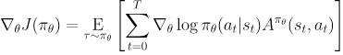
Key Idea
probabilities of actions that lead to higher return
probabilities of actions that lead to lower return
Exploration
Sample actions according to the latest version of its stochastic policy
Policy Update
Where A is the advantage function for the current policy, π is the policy,
'a' is the action and 's' is the state
Our Proposed Solution - VPG
Notes:
policy typically becomes progressively less random, as the update rule encourages it to exploit rewards that it has already found.

Slide 22
Cart Pole
Our Proposed Solution - VPG

Slide 23
A pole is attached by an un-actuated joint to a cart, which moves along a frictionless track.
The system is controlled by applying a force of +1 or -1 to the cart.
The pendulum starts upright, and the goal is to prevent it from falling over.
A reward of +1 is provided for every timestep that the pole remains upright.
The episode ends when the pole is more than 15 degrees from vertical,
or the cart moves more than 2.4 units from the center.
Our Proposed Solution - VPG

Slide 24
Advantage Actor Critic
Our Proposed Solution - A2C

Slide 25
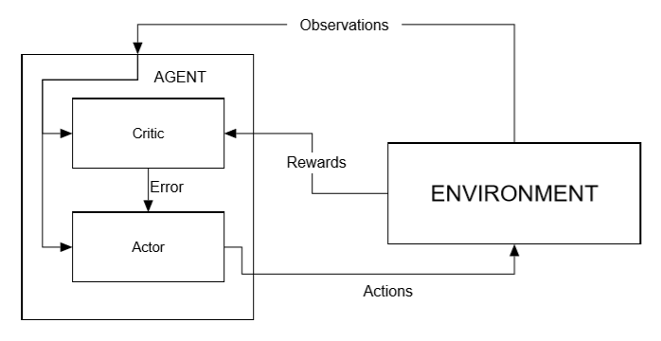
Key Idea
Aπ(s,a)=Qπ(s,a)−Vπ(s)
Exploration
advantage function, which will tell us the improvement compared to the average the action taken at that state is.
Policy Update
Our Proposed Solution - VPG
Notes:
VPG: monte-carlo (take random samples). This introduces high variability in probabilities and cumulative rewards. This leads to noisy gradients, and cause unstable learning.
Actor Critic uses two neural networks. The actor is is a policy function that controls how our agent acts. The critic is a value function that measures how good these actions are.
We introduce an advantage function, which will tell us the improvement compared to the average the action taken at that state is.

Slide 26
Policy Proximal Optimization
Our Proposed Solution - PPO
Implementation

Slide 27
In many Policy Gradient Methods, policy updates are unstable because of larger step size, which leads to bad policy updates and when this new bad policy is used for learning, it leads to further worse policy.
Many learning methods learn from current experience and discard the experiences after gradient updates.
PPO overcomes those issues.
Our Proposed Solution - PPO
Implementation

Slide 28
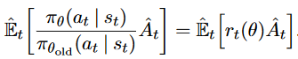
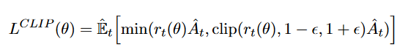
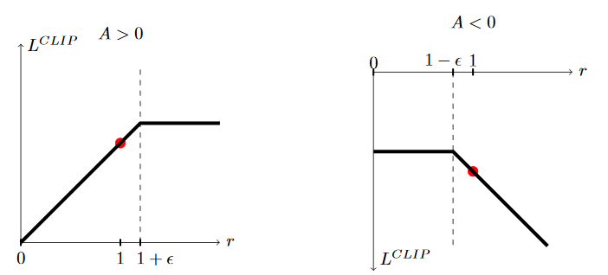
Instead of the log of current policy, PPO takes the ratio of current policy and old policy.
Clipping the ratio and take the minimum of the two (clipped and unclipped).
Our Proposed Solution - PPO
Implementation

Slide 29
Data ingestion - RAM based models
Our Proposed Solution - PPO
Implementation

Slide 30
Policy Proximal Optimization with A2C
Our Proposed Solution - PPO with A2C
Implementation

Slide 31
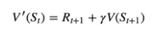
We implemented PPO with Advantage Actor Critic using :
Computed Value function:
Generalized Advantage Estimation (GAE):
Our Proposed Solution - PPO with A2C
Implementation

Slide 32
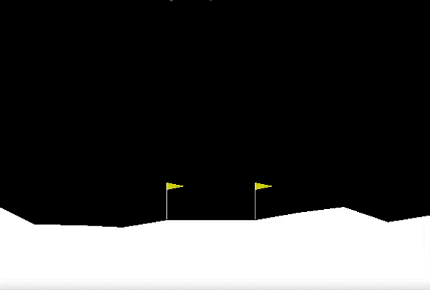
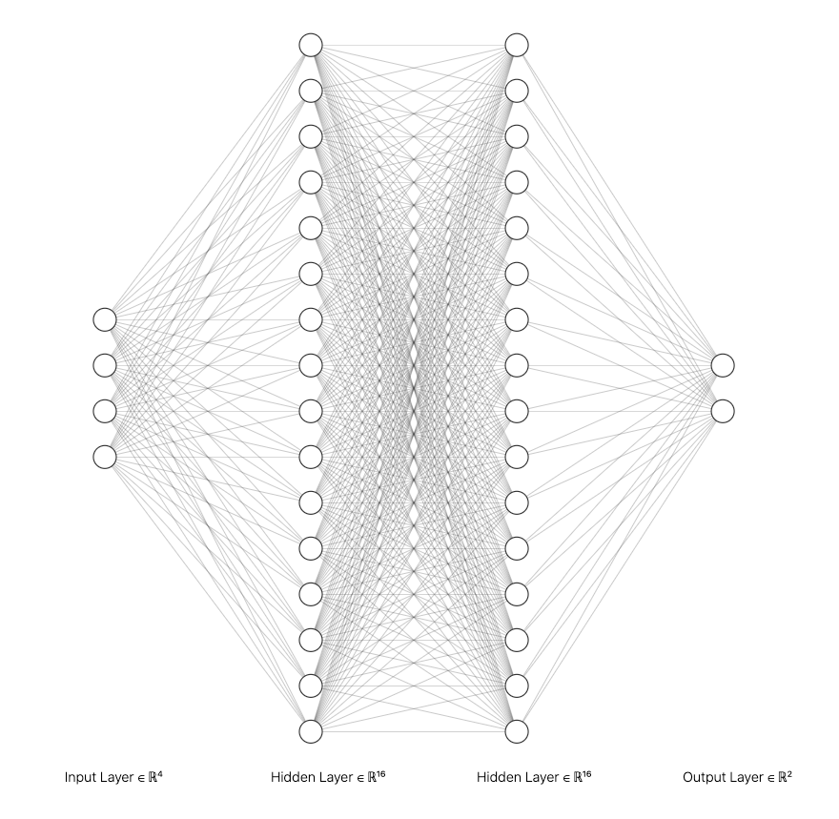
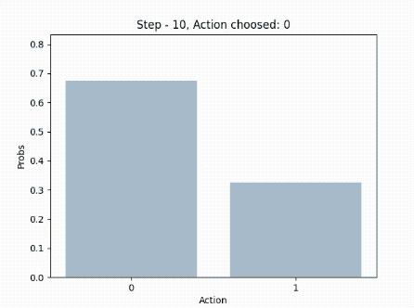
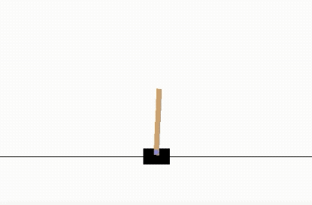
Previous models used the RAM version of AI Gym which provided a featured representation of the game state.
2 hidden layers
Tanh as activation function
Dropout
Notes:
Simpler environments: lunar lander, cart pole

Slide 33
Data ingestion - Image based models
Our Proposed Solution - PPO
Implementation

Slide 34
As we are using the raw pixels input with PPO, we do some pre-processing:
Images are transformed to grayscale, so we only use 1 channel instead of 3 (RGB) in the CNN
Images are cropped (remove top score) and resized to 50% size,
which is enough for the Atari games and will reduce computational needs.
Images are stacked in blocks of 4 (C3D) so we can get more context (like the direction and speed of the ball).
We used a multi-worker approach, so we could have multiple threads running on multiple cores training the model. Most games were trained with 12 workers.
Notes:
Atari environments: Breakout, Pong, Space Invaders.

Slide 35
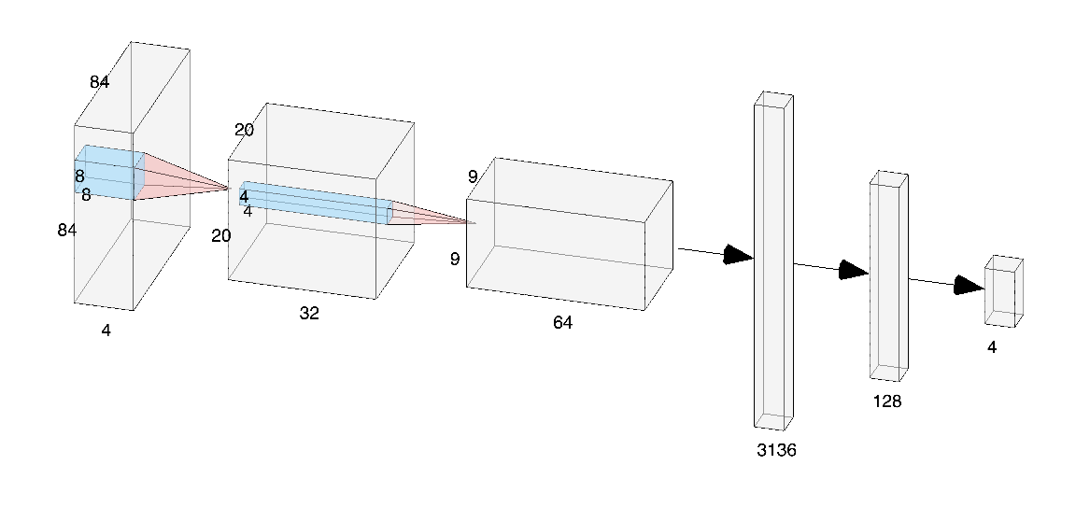
PPO for image architecture
3x3
Our Proposed Solution - PPO
Implementation

Slide 36
Results

Slide 37
The goal of this project is to solve Atari games from OpenAI Gym applying RL.
We first implemented VPG, then A2C and finally PPO in order to understand how RL algorithms work.
Results

Slide 38
All the documentation, evidences, experiments and instructions to run them can be found here:
https://github.com/DaniFojo/aidl-2020-spring-team-dani
Results

Slide 39
Experiments
Results

Slide 40
Policy Proximal Optimization - RAM
Cart Pole
Implementation
Results
Notes:
Model used:
PPO RAM
Final reward:
200
Episodes to solve:
500
Time used:
~15 min

Slide 41
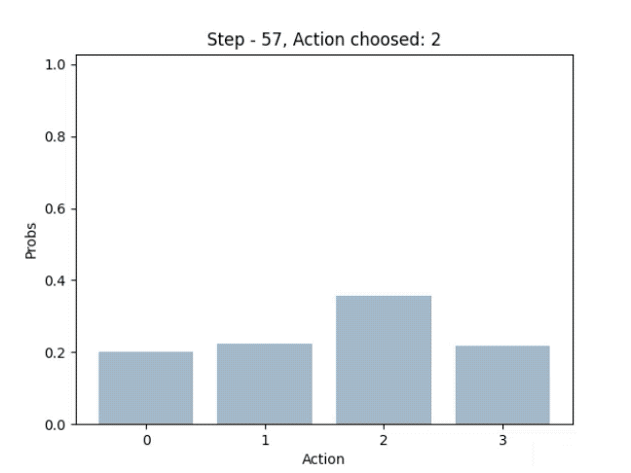
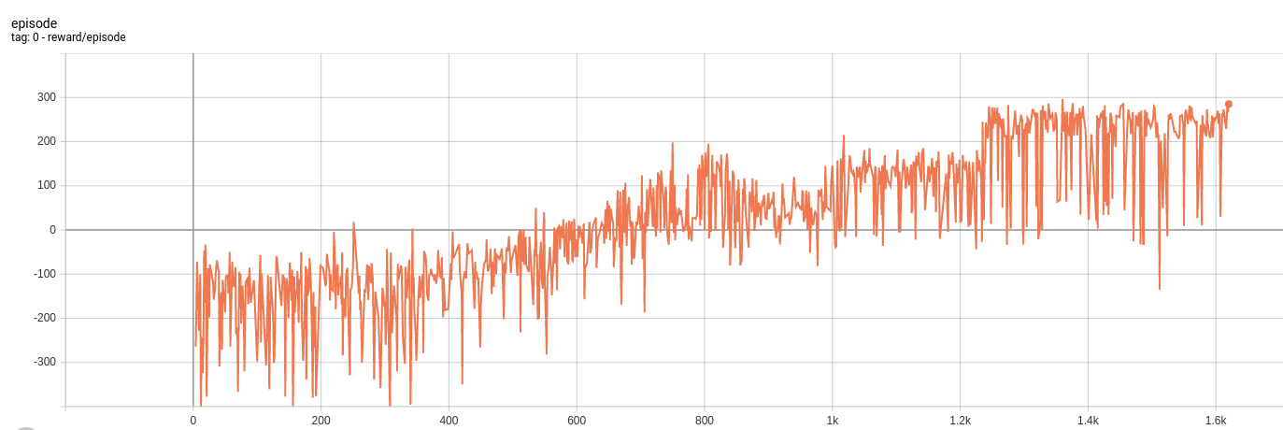
Proximal Policy Optimization - RAM
Lunar Lander
Implementation
Results
Notes:
Model used:
PPO RAM
Final reward:
> 250
Episodes to solve:
1.700
Time used:
~40 min

Slide 42
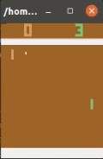
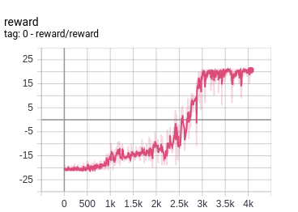
Proximal Policy Optimization - Frames
Pong
Implementation
Results
Notes:
Model used:
PPO Frames
Final reward:
21
Episodes to solve:
4K * 12
Time used:
~4.5 hours

Slide 43
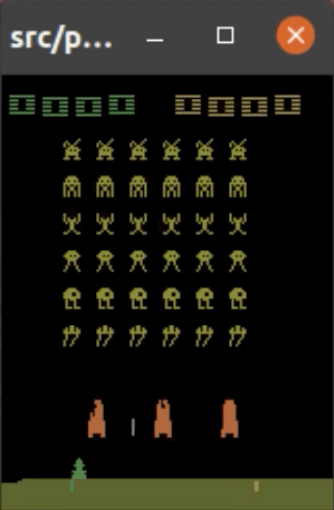
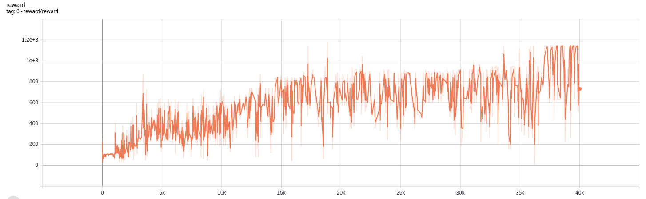
Proximal Policy Optimization - Frames
Space Invaders
Implementation
Results
Notes:
Model used:
PPO Frames
Final reward:
~ 1600
Episodes to solve:
40 K
Time used:
~ 11 hours

Slide 44
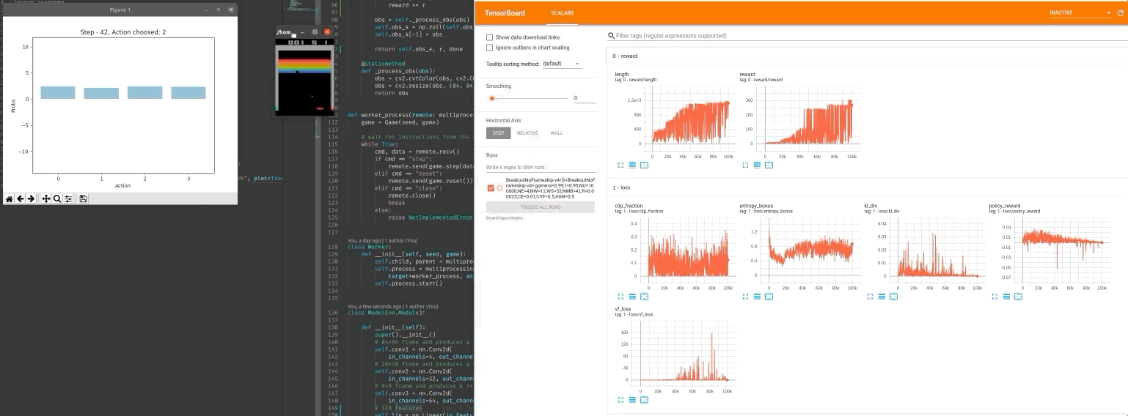
Proximal Policy Optimization - Frames
Breakout
Implementation
Results
Notes:
First model working, after 100K episodes (*12 workers)
º

Slide 45
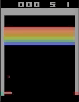
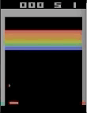
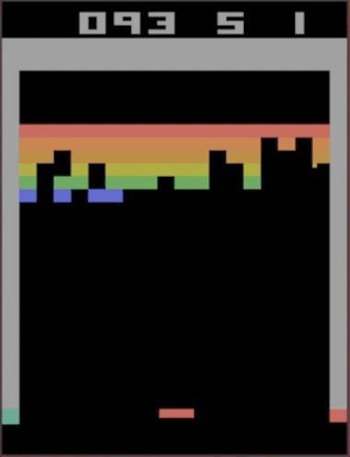
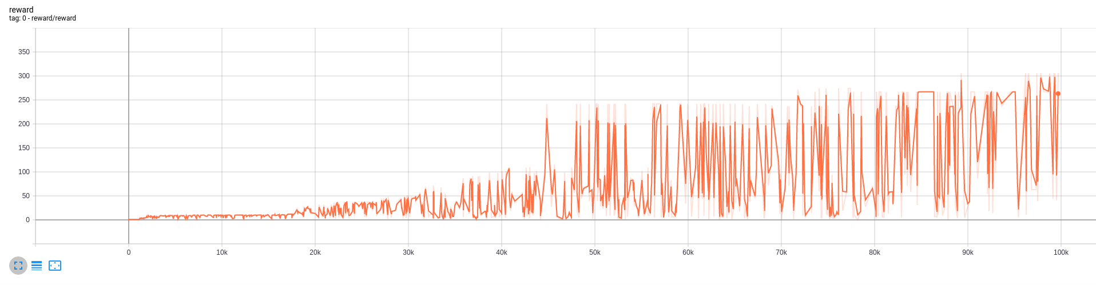
Proximal Policy Optimization - Frames
Breakout
Implementation
1k
100k
300k
Results
Notes:
Images
1k Start to play
100K Plays
300K Super performance (trick to send the ball to the top)
Model used:
PPO Frames
Final reward:
~ 360
Episodes to solve:
300K
Time used:
~ 34 hours

Slide 46
Conclusion

Slide 47
One of the first issues we faced is the hardware limitation.
It took a lot of time to train the models, and the batch size was also limited to the hardware compute power.
Conclusions

Slide 48
We have observed that in PPO with A2C the models were training successfully in simple environments, but when complexity was increased [Atari] we needed more episodes and the model was unable to solve the environments.
Conclusions

Slide 49
We have seen that it is very important to monitor the performance of the models with tools like TensorBoard.
Both monitoring and testing different techniques led us to the final algorithm, with which we would be able to train a model that was able to solve the Atari environments.
Conclusions

Slide 50
It has been very challenging, specially with PPO.
There are many factors to take into account: hyperparameters, architecture, data pre-processing, training length...
Conclusions

Slide 51
Deep Learning has a huge community behind it, which makes it easier to find help and resources.
However, some DL challenges can lead you to face very specific problems which might be cryptic and harder to solve.
We believe, right now, this is especially true for RL.
Conclusions

Slide 52
Early in the project the team reduced in size from 4 to 3
Conclusions

Slide 53
Bibliography

Slide 54
Learning from the memory of Atari 2600
https://arxiv.org/pdf/1605.01335.pdf
High-dimensional Continuous Control Using Generalized Advantage Estimation
https://arxiv.org/pdf/1506.02438.pdf
What Matters In On-Policy Reinforcement Learning? A Large-Scale Empirical Study
https://arxiv.org/pdf/2006.05990.pdf
Stabilizing Transformers For Reinforcement Learning
https://arxiv.org/pdf/1910.06764.pdf
RL — Proximal Policy Optimization (PPO) Explained | by Jonathan Hui
https://medium.com/@jonathan_hui/rl-proximal-policy-optimization-ppo-explained-77f014ec3f12
A (Long) Peek into Reinforcement Learning
https://lilianweng.github.io/lil-log/2018/02/19/a-long-peek-into-reinforcement-learning.html
Proximal Policy Optimization Algorithms
https://arxiv.org/pdf/1707.06347.pdf
Proximal Policy Optimization
https://openai.com/blog/openai-baselines-ppo/
Proximal Policy Optimization (PPO)
https://towardsdatascience.com/proximal-policy-optimization-ppo-with-tensorflow-2-x-89c9430ecc26
RL — Proximal Policy Optimization (PPO) Explained
https://medium.com/@jonathan_hui/rl-proximal-policy-optimization-ppo-explained-77f014ec3f12
Bibliography

Slide 55
Understanding Actor Critic Methods and A2C
https://towardsdatascience.com/understanding-actor-critic-methods-931b97b6df3f
Cartpole - Introduction to Reinforcement Learning (DQN - Deep Q-Learning)
https://towardsdatascience.com/cartpole-introduction-to-reinforcement-learning-ed0eb5b58288
Docs » Proximal Policy Optimization
https://spinningup.openai.com/en/latest/algorithms/ppo.html#documentation-pytorch-version
RL — Policy Gradient Explained
https://medium.com/@jonathan_hui/rl-policy-gradients-explained-9b13b688b146
RL — Policy Gradients Explained (Part 2)
https://medium.com/@jonathan_hui/rl-policy-gradients-explained-advanced-topic-20c2b81a9a8b
Asynchronous Methods for Deep Reinforcement Learning
https://arxiv.org/pdf/1602.01783.pdf
Reinforcement learning algorithms with Generalized Advantage Estimation
https://github.com/bsivanantham/GAE
Proximal Policy Optimization Tutorial (Part 1/2: Actor-Critic Method)
https://towardsdatascience.com/proximal-policy-optimization-tutorial-part-1-actor-critic-method-d53f9afffbf6
Proximal Policy Optimization Tutorial (Part 2/2: GAE and PPO loss)
https://towardsdatascience.com/proximal-policy-optimization-tutorial-part-2-2-gae-and-ppo-loss-fe1b3c5549e8
Applications of Reinforcement Learning in Real World
https://towardsdatascience.com/applications-of-reinforcement-learning-in-real-world-1a94955bcd12
Bibliography

Slide 56
Human-level control through deep reinforcement learning
https://storage.googleapis.com/deepmind-media/dqn/DQNNaturePaper.pdf
Playing Atari with Deep Reinforcement Learning
https://deepmind.com/research/publications/playing-atari-deep-reinforcement-learning
UC Berkeley Reward-Free RL Beats SOTA Reward-Based RL
https://syncedreview-com.cdn.ampproject.org/v/s/syncedreview.com/2020/09/21/uc-berkeley-reward-free-rl-beats-sota-reward-based-rl/amp/?usqp=mq331AQFKAGwASA%3D&amp_js_v=0.1#referrer=https%3A%2F%2Fwww.google.com&amp_tf=De%20%251%24s&ampshare=https%3A%2F%2Fsyncedreview.com%2F2020%2F09%2F21%2Fuc-berkeley-reward-free-rl-beats-sota-reward-based-rl%2F
From 0 to 200 - lessons learned from solving Atari Breakout with Reinforcement Learning
http://blog.jzhanson.com/blog/rl/project/2018/05/28/breakout.html
ACCELERATED METHODS FOR DEEP REINFORCEMENT LEARNING
https://arxiv.org/pdf/1803.02811.pdf
Bibliography

Slide 57
Questions?

